Slide 1

Analyzing the Relationships Between Population and Organic Agricultural Sales
Christopher De La Rosa

Slide 2
Background
Big cultural shift in favor of organic agriculture
Expensive, so good sales necessary
Finding predictors for economic health is tricky

Slide 3
Is there a statistically significant correlation between population and total dollar sales, population and total per capita dollar sales, and total dollar sales and total per capita dollar sales?
Question

Slide 4
Hypotheses
H0: No relationship is statistically significant.
H1: One relationship is statistically significant.
H2: Two relationships are statistically significant.
H3: Three relationships are statistically significant.
H2 is expected
More statistically significant relationships = more confidence as predictors

Slide 5
Methodology
Data taken from National Agricultural Statistics Service subdivision of USDA and into DataFrame
Per capita numbers were calculated for each sales metric
Plotting through matplotlib and regression statistics through scipy

Slide 6
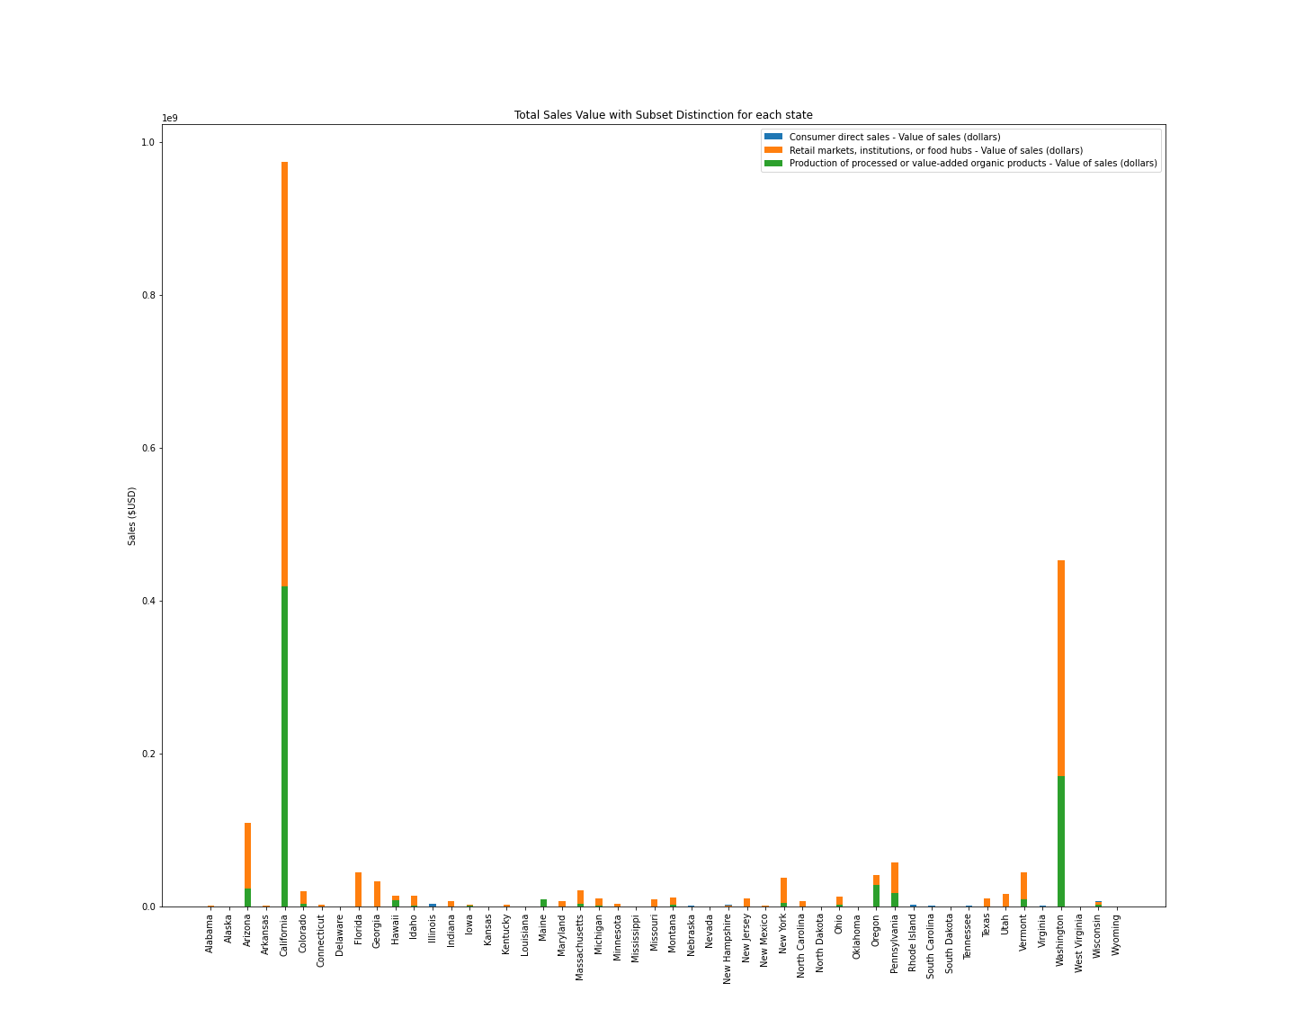
Visualization of Sales

Slide 7
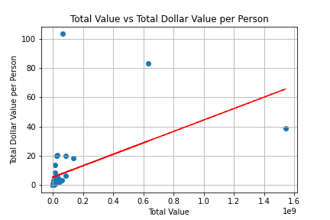
Population vs Total Dollar Sales per capita
Slope | Intercept | R-Value | P-Value | Std. Error
1.791e-7 | 6.534 | 0.069 | 0.636 | 3.756e-7

Slide 8
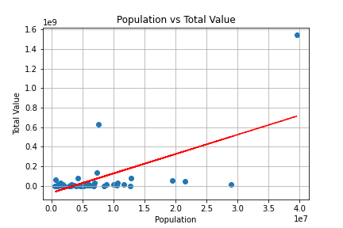
Population vs Total Dollar Sales
Slope | Intercept | R-Value | P-Value | Std. Error
19.802 | -69645256.36 | 0.630 | 9.574e-7 | 3.525

Slide 9
Total Dollar Sales vs Total Dollar Sales per capita
Slope | Intercept | R-Value | P-Value | Std. Error
3.916e-8 | 5.355 | 0.472 | 0.001 | 1.055e-8

Slide 10
Conclusions
H2 is correct hypothesis
There is an extremely loose transitive relationship
Overall idea of project could be good research idea

Slide 11
References
Bialik, K., & Walker, K. (n.d.). Organic farming is on the rise in the U.S. Pew Research Center. Retrieved April 4, 2021, from https://www.pewresearch.org/fact-tank/2019/01/10/organic-farming-is-on-the-rise-in-the-u-s/
Donald W. Lotter. (2003). Organic Agriculture, Journal of Sustainable Agriculture, 21:4, 59-128, DOI: 10.1300/J064v21n04_06
National Agricultural Statistics Service. (2020). 2017 Census of Agriculture - 2019 Organic Survey. United States Department of Agriculture. https://www.nass.usda.gov/Publications/AgCensus/2017/Online_Resources/Organics/ORGANICS.pdf.
Ostapenko R, Herasymenko Y, Nitsenko V, Koliadenko S, Balezentis T, Streimikiene D. Analysis of Production and Sales of Organic Products in Ukrainian Agricultural Enterprises. Sustainability. 2020; 12(8):3416. https://doi.org/10.3390/su12083416
United States Census Bureau. (2019). QuickFacts Population Estimates, July 1, 2019 (V2019). https://www.census.gov/quickfacts/geo/chart/US/PST045219.
Willer, E. H., & Lernoud, J. (2019). The World of Organic Agriculture Statistics and Emerging Trends 2019. 351.

